Slide 1
Lecture 5: marriage and cohabitation
SC22o5: Sociology of the family

Slide 2
Announcement
For Weeks 5 and 6, discussion group sessions will include library sessions
Discussion group sessions will take place in the regular venues before students adjourn for the library sessions
Friday 11 September is a public holiday
Students in D2 may join any of the other discussion group sessions

Slide 3
Announcement
D1 | 8 September | 2.30pm – 3.30pm | Central Library Training Room
D3 | 9 September | 2.30pm – 3.30pm | Central Library Theatrette 2 (Students to bring their own laptops)
E1 | 15 September | 2.30pm – 3.30pm | Central Library Training Room
E2 | 18 September | 12.30pm – 1.30pm | Central Library Training Room
E3 | 16 September | 2.30pm – 3.30pm | Central Library Training Room

Slide 4
Research paper outline
Common questions
Where are the research paper outline instructions?
Do we present the outline in point form or sentences? Either way also can
Do we have to write 1000 words?
A soft copy should be submitted to IVLE and a hard copy to your tutor’s mailbox by
5pm on Tuesday 15 September

Slide 5
Where we have been…
Introduction to sociology of the family
Family as a social construct
Normal family ideology
Conceptual frameworks in the analysis of the family

Slide 6
Where we are going…
Family Formation, Transitions, and Dissolution
Romantic love and courtship
Marriage and cohabitation (Today)
Gender and the division of labor
Parenthood
Divorce

Slide 7
In this lecture…
Marriage and cohabitation
Societal influences on intimate relationships
Power in couples
Marriage and cohabitation

Slide 8
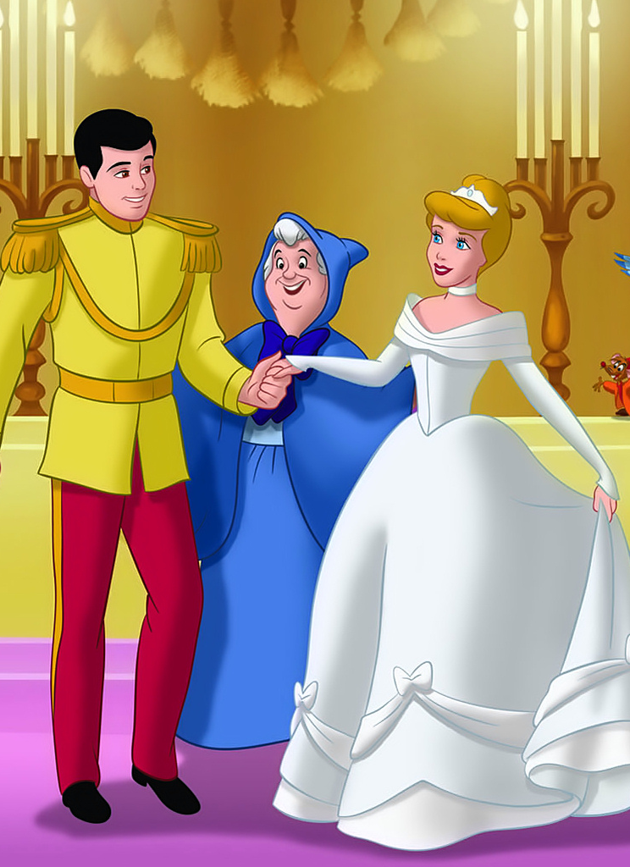
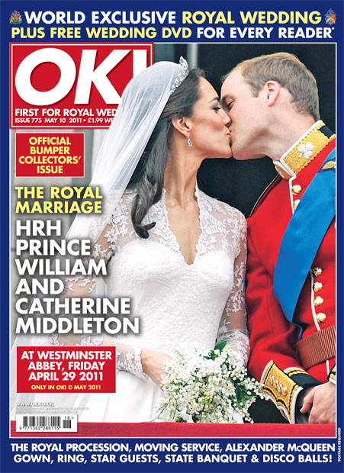
Romance of Weddings…

Slide 9


Romance of Weddings…

Slide 10
Negative images of the ensuing Marriage…
Marriage is a three ring circus: engagement ring, wedding ring, suffering
Marriage is not a word, it is a sentence – a life sentence
Marriage is a great institution but I am not ready to live in an institution
I do not worry about terrorism; I was married for two years
Notes:
Man-marriage is something bad, while for women is look upon as something important
Marriage is still the pinnacle of relationships.

Slide 11
Societal influences on intimate relationships: Exogamy and Endogamy

Slide 12
Exogamy
Intimate relationships are universal
At any given point in time, each one of us is a member of many groups simultaneously
Exogamy
Rules that require an individual to form a long-term romantic relationship with someone outside certain social groups
In South Korea, for example, individuals are discouraged from marrying someone with the same surname- not that rigid now but still prevalent.
Incest
In almost all societies, exogamy rules define marrying or having sex with individuals in one’s own immediate family (siblings, parents, children)
Notes:
Culturally ascribed norms is still important in forming relationships

Slide 13
Endogamy
Endogamy
Rules that limit intimate choices to individuals within one’s social group, principally race, religion, and social class
Education and employment patterns
⬇
Common beliefs, values, and experiences
Rules of endogamy reflect our society’s traditional distaste for relationships that cross group boundaries

Slide 14
Race
The strength of racial endogamy rules varies from group to group
Intermarriage rates are affected by social class, opportunities to interact with members of other racial groups, and increasing numbers of newly arrived immigrants
Intermarriage is more common among individuals with tertiary education- due to more contact
Where ethnic communities are strong and concentrated (big), rules of endogamy tend to be powerful impediments to intermarriage (for example, Chinese Americans)
Racism before and after marriage
Everyday activities will require more time and effort

Slide 15
Religion
Most religions discourage interfaith marriages
Children growing out in a different faith or even take religion out of the family completely
Religious endogamy reflects the influence of religion on individual’s behaviors and expectations
Marriage to someone of a different faith or even no faith
Willingness to convert
Rather important

Slide 16

Social class and education
Social class and education are powerful factors in marriage
Members of the upper class face strong pressures to choose partners of similar social standing
Highly educated individuals tend to marry other highly educated individuals
Notes:
Movies: Things such as social class do not impediment marriages.

Slide 17
Societal influences on intimate relationships: social expectations

Slide 18
Expectation of interdependence
Interdependence
The degree to which partners rely on each other to provide needed resources such as affection, companionship, sex, and money
Women more dependent- stabilize marriages
Does women’s economic dependence stabilize marriages?
Specialization
Each partner develops some skills and neglects others as each can count on the other to take responsibility for some work involved in making a home or living
Decling expectations of economic dependence reduces the interest in marriages
But due to higher standards of living; economic dependence still occur

Slide 19
Expectation of equity
Equity
The level of perceived fairness or justice that exists in a relationship
According to the social exchange model, relationships work best when the exchange is equitable – couples work best when the contribute equally
The presence or absence of interpersonal equity has profound effects on the satisfaction felt by individuals as well as the stability of the relationship itself (Gerson 2010)

Slide 20
Expectation of equity
Investment
Anything that an individual can offer to a relationship, such as time, money, interest, or personal characteristics, that creates feelings of entitlement or deservedness
Imbalances have the potential of creating serious and potentially dangerous power differences in relationships
Notes:
“you deserve better”

Slide 21
Expectation of commitment
Expectation of permanence
Commitment
Personal dedication to a relationship
A desire to maintain and improve it for the benefit of both partners
Despite increasing divorce rates, most couples marry with the expectation that they will be married forever
Although cohabiting relationships are shorter than marriages, many cohabiting couples expect that their relationships will be permanent
Expectations of permanence vary widely among different social groups
Notes:
Expect to into another person’s defence
If things will balance up in the long term then temporary imbalances are tolerated

Slide 22
Expectation of sexual access
Expectation of sexual exclusivity
Traditionally, heterosexual marriages were created by establishing sexual ties
Annulment
A declaration that a marriage is null and void as a key term of the marriage contract has not been put into effect
In traditional societies, a woman’s body was the sexual property of her husband
Marriage is considered a contract for exclusive sexual rights between two partners
Notes:
In UK, the threat is that the property is passed down to the wrong child

Slide 23
Expectation of being a couple
Individuals in long term relationships behave, feel, and think like a couple
As relationships progress, couples construct this new couple identity for themselves and, through interaction with each other, reinforce it
Third parties also play an important role in reinforcing the couple’s new identity
Notes:
New expectations of the couples, going to events together and knowing where they are together.

Slide 24
Power in couples

Slide 25
Power in couples
Being part of a couple requires many choices and decisions
The way they make all these decisions depends on the way they structure relationships of power and authority
The expression of power in intimate relationships emerges from the interactions and personalities of the specific individuals
But couples are also embedded in a social system that perpetuates unequal rewards and life chances in society

Slide 26
Power in couples
In a society stratified along gender lines, social power can play out in interesting ways within couples’ lives
Individuals entering into long term relationships are starting to acknowledge that gender norms are changing, and more couples today are trying to establish relationships in which power is balanced
However, most heterosexual relationships continue to be dominated by male partners – resources are more unevenly distributed; men are less likely to view advantages that the society provides them
Gerson (2010) shows us that even though women have gained ground economically, traditional gender expectations continue to exert powerful influence over individual’s family experiences

Slide 27
Marriage and cohabitation

Slide 28
expectations that have traditionally accompanied marriage…
It is something all adults should do
It is a relationship available only to one man and one woman
It is supposed to last forever
It means couples will have (or at least want to have) children
It provides clear roles of husbands/fathers and wives/mothers

Slide 29
Some facts about marriage today…
More and more adults are choosing not to marry, and those who do marry are waiting longer
Same-sex couples continue to fight for their right to legally marry
More and more couples are choosing to delay childbearing or to remain childless
Traditional gender roles in marriage are significantly less common than they were even 20 years ago
Are marriages really like any other committed intimate relationships?

Slide 30
Cohabitation (Stages)
Couples cohabit either as a way of testing their compatibility before marriage or as a permanent alternative to marriage
Most cohabiting relationships last for about a year until they either end or transform into marriage
A fringe activity
A testing ground
An acceptable alternative
Identical to marriage

Slide 31
Cohabitation versus marriage
Cohabiters report significantly lower satisfaction and happiness with their relationships than spouses do
Cohabiters are almost twice as likely as spouses to report that they believed their relationship was in trouble over the past year
Male cohabiters are much more likely than husbands to view themselves as benefiting more from the relationship
Cohabiters report poorer relationships with their parents, face more social disapproval, and receive less social support than married couples
Young adults become more tolerant of divorce as a result of cohabiting
Spouses who cohabited prior to marriage have higher rates of separation and divorce than spouses who did not cohabit before marriage

Slide 32
Cohabitation versus marriage
Many relationship rules and expectations apply to both types of relationships but to different degrees
Violating rules in a cohabiting relationship where such rules might not be obvious can be more disruptive than any comparable violation in marriage
For example, when a traditional social norm regarding the male breadwinner roles had been violated

Slide 33
Unique aspects of marriage: the marriage contract
The legal contract that binds spouses in marriage adds formality to the union and a set of rights and obligations
It can also make termination of the marriage difficult and complicated
Scandinavian countries grant unmarried cohabiting couples the same rights and benefits as married couples
The marriage contract is only relevant when entering into family arrangements or exiting them

Slide 34


Unique aspects of marriage: The wedding ceremony

Slide 35


Unique aspects of marriage: The wedding ceremony
Notes:
Important ritual
Prof tip: don’t say getting married HAHAHA too expensive

Slide 36
Unique aspects of marriage: The wedding ceremony
The symbolic importance of the wedding ceremony
At the time of their wedding, their family and friends, along with the state and often a religious institution, bestow on the couple a type of approval, honor, and esteem that is unique and obtainable by no other discernable means
Beyond the wedding, whenever they make known their marital status, strangers immediately accord them the respect appropriately due that position
Wedding ceremonies also reaffirm the primacy of heterosexuality found in society

Slide 37
Unique aspects of marriage: The institutionalized nature of marriage
Marriage
Cohabitation
Marriage remains a patterned way of life that includes a set of commonly known roles, statuses, and expectations
“Husband” and “wife”
The law provides support for the institution of marriage
What it means to be a cohabiting individual is much less clear
“Significant other”, “life partner”, “lover”, “intimate roommate”?
Cohabiters are in a position of legal insecurity
Notes:
Differing respect for roles and terms
Couples who get divorced might still need responsibilities after it ends
Cohabiting relation hard to have legal status, have no involvement in the state of health, more legal and financial security

Slide 38
The marriage benefit
Married individuals enjoy a wider range of health benefits compared to single, divorced, cohabiting, and widowed individuals
Marriage provides individuals with someone who monitors their health and discourages risky and unhealthy behaviors
Good marriages provide individuals with a sense of being cared for, loved, and valued as an individual
Marriage in and of itself is not what creates these physical and psychological benefits
The quality of the relationship is far more important

Slide 39
The marriage benefit
Marriage in some societies is recognized openly as an economic arrangement
Marriages are important as they provide economic links between kin groups
In societies that have an elaborate and highly structured stratification system, such as India and Pakistan, a family’s social status is important in determining who is eligible to marry whom
Marriages are usually arranged from within the same caste

Slide 40
The marriage benefit
Economic benefits
The division of labor in marriages allows each spouse to specialize in specific skills and tasks; in time, this specialization can become efficient and productive
Married couples benefit as they are able to share resources (housing, food, utilities), which minimizes the cost of living and provides insurance against unemployment or an unexpected illness
Marriage broadens social support systems and increases participation in other social institutions; connections established in these activities can lead to additional opportunities and benefits
Married couples have access to health or life insurance through a spouse’s employment

Slide 41
The marriage problem
Marriage is not a cure-all for society’s problems
For example, there is no pool of financially stable men looking to marry poor, unwed mothers
The elevation of marriage to its exalted status in society has led individuals to expect too much from their spouses (Coontz 2005)
The growing belief that individuals can receive all their emotional sustenance and fulfillment from their spouses has created an increased sense of isolation
Notes:
Marriage alone cannot offset the financial situation of raising the child alone

Slide 42
The marriage problem
The relationship between marital status and wages is different for women than it is for men
Among married women, only those who are childless enjoy increased wages
Once they become mothers, marriage actually decreases their earnings as many mothers choose or are forced to reduce their hours at work
Married women experience higher rates of some types of mental and physical illness and distress than married men
Women’s increased labor force participation has not been met been matched with men’s increased involvement in the home
Studies also suggest that the health benefits that married women experience are often the result of their greater economic resources provided by their husband’s income

Slide 43
Summary
Mate selection is strongly influenced by cultural rules of endogamy and exogamy
Modern relationships are more flexible than ever before, but they are still governed by expectations of interdependence, equity, commitment, permanence, sexual access, and sexual exclusivity
Couples still feel pressured to be “coupled”
Despite women's increased economic role, men continue to have more power in intimate relationships
Cohabitation and marry vary in several important ways
The institutionalized nature of marriage appears to bestow health and economic benefits on married individuals but this evidence must be interpreted with caution

